Slide 1
Designing the Snake Game
on Basys-3 with VGA and Joystick Pmod
Huu Nhan Nguyen, Julia Gu
CS M152A

Slide 2
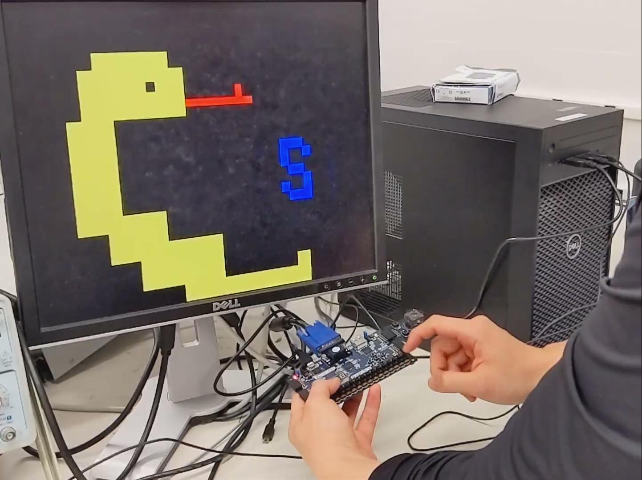
Demo
Joystick:
Supports four directions
Does not allow backward movement
Game logic:
Start and reset buttons drive states
Collisions with wall or self lead to loss screen
Length of snake increments after collecting a target
Loss screen shows final target count

Slide 3
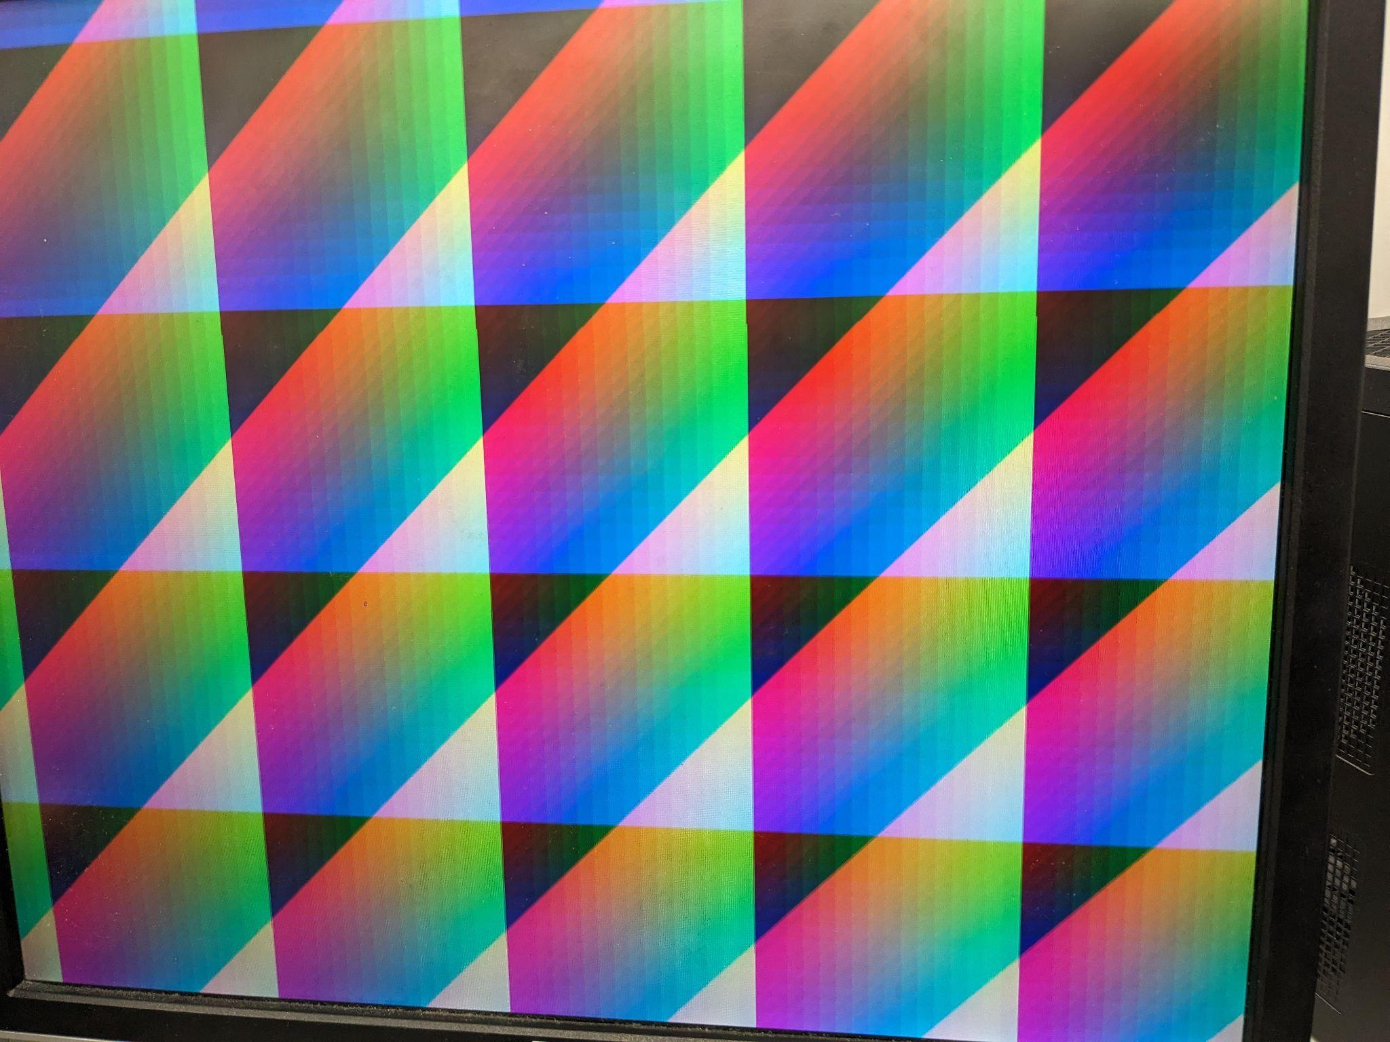
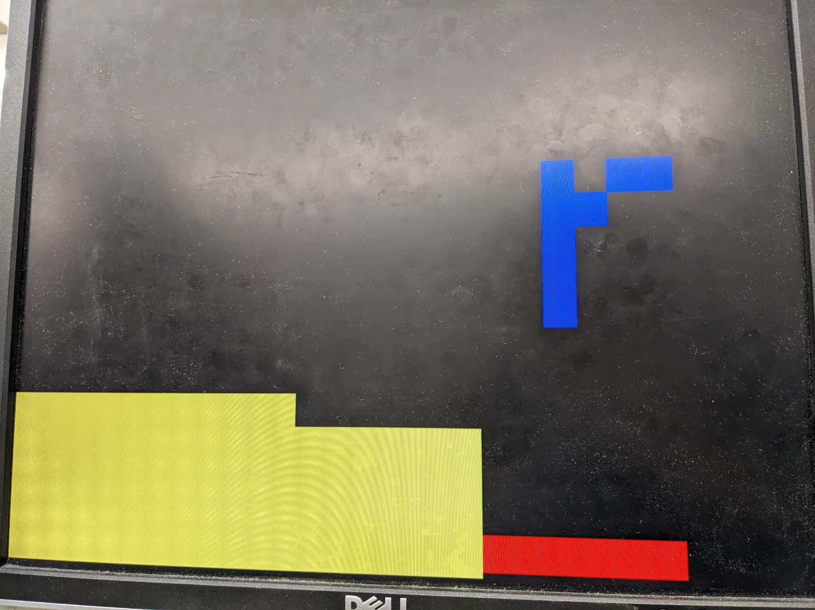
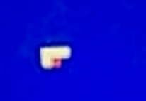
Challenges
Connection between Basys 3 board with joystick and VGA
The snake could only turn every other cell
Source of bug
Snake’s refresh rate was faster than joystick’s send/receive rate
Program did not receive joystick input in time to turn

Slide 4
Special thanks!
Melissa’s group for link to VGA starter code
Ruining for link to joystick starter code
Solution
Increased send/receive rate to twice snake’s refresh rate

Slide 5
Design
↓ Navigation_state_machine
BTNU
UP
LEFT
BTNL
↓ Master_state_machine
↓ PmodJSTK
BTNR
BTNU
BTND
BTNL
Y
RESET
LOST
BTNR
BTNU
RIGHT
DOWN
START
RESET
LOST
BTND
BTNL
BTNR
X
PLAY
BTNC
BTND
Notes:
These are some diagrams for a very small subset of our design. We have two main finite state machines and a helpful visual for how we got four directions from our joystick input.
This first one is our master state diagram. You probably saw from our demo that we had three states in our program. There was the start state, the play state, and the loss state, and these are the transitions.
The second one is our state diagram for the directions of the snake. What’s important is that there are no arrows directly between UP and DOWN, or LEFT and RIGHT, because the snake cannot go directly from up to down, or from left to right.
The third one is a visual representation of our joystick. Each trapezoid corresponds to a direction signal. We used the values of X and Y to determine which region the joystick input fell in.

Slide 6
Modules (by theme)
Top module
snake_wrapper
Game logic
Master_state_machine
Snake_control
Navigation_state_machine
random_num_gen
Generic_Counter
VGA
VGA_module
Generic_Counter
Joystick
PmodJSTK_Demo
PmodJSTK
spiCtrl
SPImode0
ClkDiv_5Hz
ClkDiv_66_67kHz

Slide 7
Q&A

Slide 8
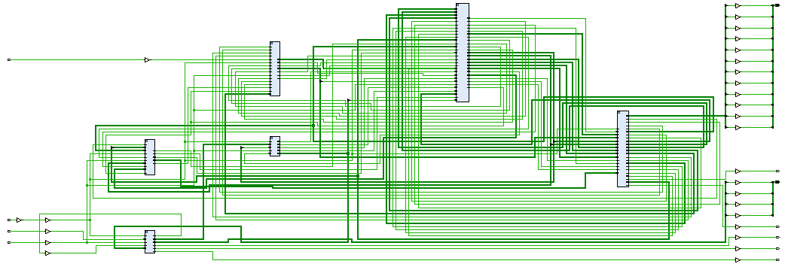
Modules (hierarchy)
snake_wrapper
Master_state_machine
Snake_control
Generic_Counter
Navigation_state_machine
random_num_gen
VGA_module
Generic_counter
PmodJSTK_Demo
PmodJSTK
spiCtrl
SPImode0
ClkDiv_66_67kHz
ClkDiv_5Hz

